Slide 1
Windows Tech Series Secure Boot and Device Guard
Speaker 1
Title
Speaker 2
Title

Slide 2
Agenda
Day | Day 1 Deployment | Day 2 Management | Day 3 Security | Day 4 Windows for CSP
 |  |  |  | Deployment | Management | Security
Synopsis | Module 1 – Introduction | Module 1 – Base System Setup | Module 1 – Analysis Of Common Threats | Module 1 – Windows for SMB Partners
 | Module 2 – Applications & Updates | Module 2 – Configuration | Module 2 – Hardening Windows | Module 2 – Windows Ent. Subscription
 | Module 3 – Windows as a Service (WaaS) | Module 3 – Managing Client Devices | Module 3 – Advanced Threat Protection | Module 3 – Deployment
 | Module 4 – Browsers & Internet Security | Module 4 – Advanced management options I | Module 4 – Information Security (AIP/WIP) | Module 4 – Managing Updates
 | Module 5 – Secure Boot & Device Guard | Module 5 - Advanced management options II | Module 5 – Internet Security

Slide 3
Background
UEFI compatibility introduced in Windows 7 (x64)
Windows 7 x64 has limited support for UEFI video, needs legacy video support to boot to point where a Windows video driver can take over.
Support on Class 2 systems running in legacy BIOS-compatibility mode by using a CSM, so they can use the legacy BIOS INT10 features.
Not supported on Class 3 systems, assumes the presence of legacy BIOS INT10 support not available in a Class-3 UEFI implementation.
A Majority of Windows 7 was deployed using Legacy BIOS

Slide 4
Challenges
Windows 10 – Virtualization based security
Requires “Native” UEFI Deployment
GPT Partitioned Disks
Firmware Configuration (BIOS -> UEFI)
User Data MUST be moved off of the machine
Integration of Vendor Tools to manipulate firmware
Some instances require Firmware Upgrades

Slide 5
Virtualization-Based Security Requirements
Requirement | Description
Windows 10 Enterprise | The PC must be running Windows 10 Enterprise.
UEFI firmware version 2.3.1 or higher with UEFI Secure Boot and Platform Secure Boot | UEFI Secure Boot ensures that the device boots only authorized code. Additionally, Boot Integrity, also known as Platform Secure Boot must be supported. Validate it against the following Windows Hardware Compatibility Program requirements: System.Fundamentals.Firmware.UEFISecureBoot System.Fundamentals.Firmware.CS.UEFISecureBoot.ConnectedStandby
Virtualization extensions | Virtualization extensions are required to support virtualization-based security: Intel VT-x or AMD-V Second Level Address Translation
Firmware lock | Firmware setup should be locked to prevent other operating systems from starting and to prevent changes to the UEFI settings. Require a firmware password or higher authentication to change firmware settings.
x64 architecture | The features that virtualization-based security uses in the Windows hypervisor can only run on a 64-bit PC.
A VT-d or AMD-Vi IOMMU (Input/output memory management unit) | In Windows 10, an IOMMU enhances system resiliency against memory attacks.
Secure firmware update process | To verify that the firmware complies with the secure firmware update process, you can validate it against the System.Fundamentals.Firmware.UEFISecureBoot Windows Hardware Compatibility Program requirement.
Signed processor microcode updates | If the processor supports it, you must require signed microcode updates.

Slide 6
What do we need to do?
Convert the disk from MBR to GPT
Configure the firmware to support VBS Features
SecureBoot
UEFI Boot (NO CSM)
Enable Virtualization Features
Move User State
Deploy Windows!

Slide 7
Preparing Systems for Device Guard
Assess Systems
Device Guard and Credential Guard Readiness Tool
“Device Guard Ready” systems
Prepare Systems
Enable UEFI
Enable and Configure SecureBoot
Partition storage for EFI
Deploy Windows 10
Usage:
DG_Readiness.ps1 -[Capable/Ready/Enable/Disable] -[DG/CG/HVCI] -[AutoReboot] -Path
Log file with details is found here: C:\DGLogs
To enable Device Guard or Credential Guard. If you have a custom SIPolicy.p7b, use the -Path parameter. Otherwise, the default policy is used.
Usage: DG_Readiness.ps1 -Enable OR DG_Readiness.ps1 -Enable -Path <full path to the SIPolicy.p7b>
To enable only HVCI
Usage: DG_Readiness.ps1 -Enable -HVCI
To enable only Credential Guard
Usage: DG_Readiness.ps1 -Enable -CG
To verify if Device Guard or Credential Guard is enabled
Usage: DG_Readiness.ps1 -Ready
To disable Device Guard or Credential Guard
Usage: DG_Readiness.ps1 -Disable
To verify if Device Guard or Credential Guard is disabled
Usage: DG_Readiness.ps1 -Ready
To verify if this device is Device Guard or Credential Guard capable
Usage: DG_Readiness.ps1 -Capable
To verify if this device is HVCI capable
Usage: DG_Readiness.ps1 -Capable -HVCI
To automatically restart with each option
Usage: DG_Readiness.ps1 -[Capable/Enable/Disable] -AutoReboot
To verify if this device is capable and matches what partners use within the Hardware Lab Kit.
Usage: DG_Readiness.ps1 -Capable -HLK

Slide 8
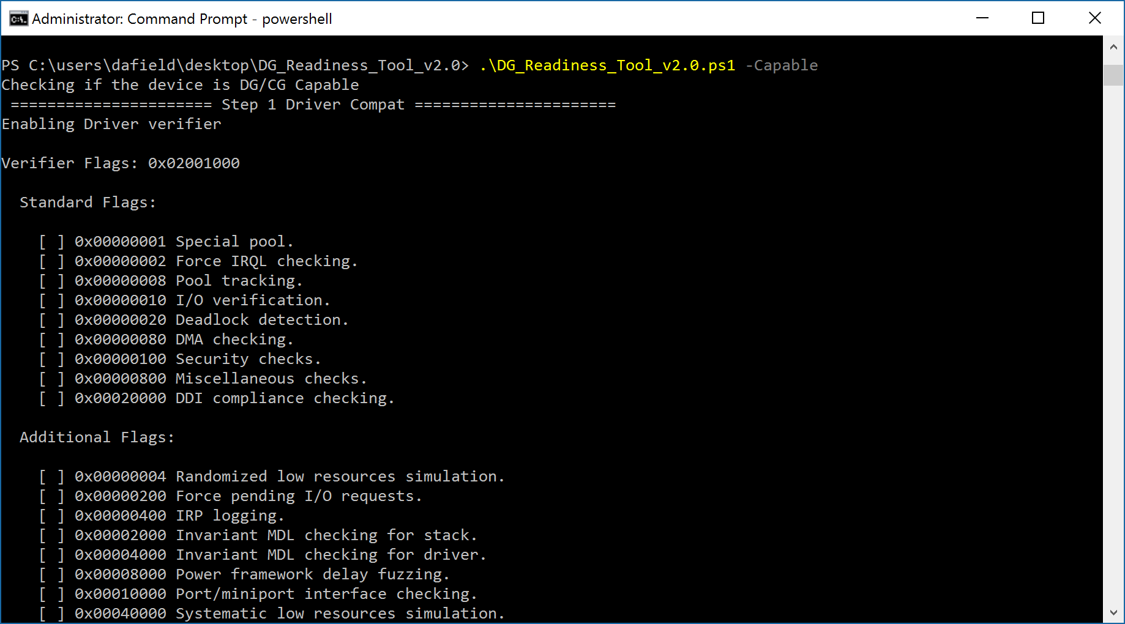
Assessing Systems
Instructions for DG_Readiness are in ReadMe.txt

Slide 9
Prepare for Device Guard
Enabling UEFI
Tricky to Automate
May consider using Deskside Support in all but the largest install bases
Preparing Storage
MDT and SCCM can automate disk preparation and image deployment on UEFI-enabled systems
Enable UEFI and then use Media or PXE to initiate image deployment

Slide 10
Device Guard Lab Module 01-13: Device Guard - Configurable Code Integrity Policy

